Slide 1
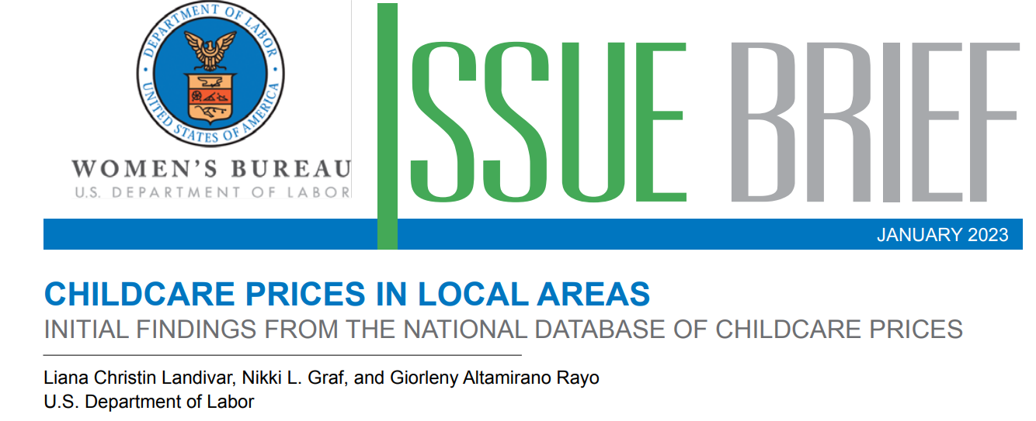

Speaker: Marie LONTSIE
Course’s Instructor: Dr. Roland Krause
Data Visualization: January 24th, 2024 1/10

Slide 2
Outline
Childcategories
Care Setting
Center-based care and home-based or family-based care
Childcare Costs over time in USA
comparison between center_based care and home-based care for different child category
Unemployment Rate over time
Unemployment rate by gender and age group
Unemployment rate correlation and childcare costs
Correlation between childcare costs, population size, and household income
Median County Childcare Price by age of children, care setting, and county population size
Infant center-based care by county size
Data Visualization: January 24th , 2024 2/10

Slide 3



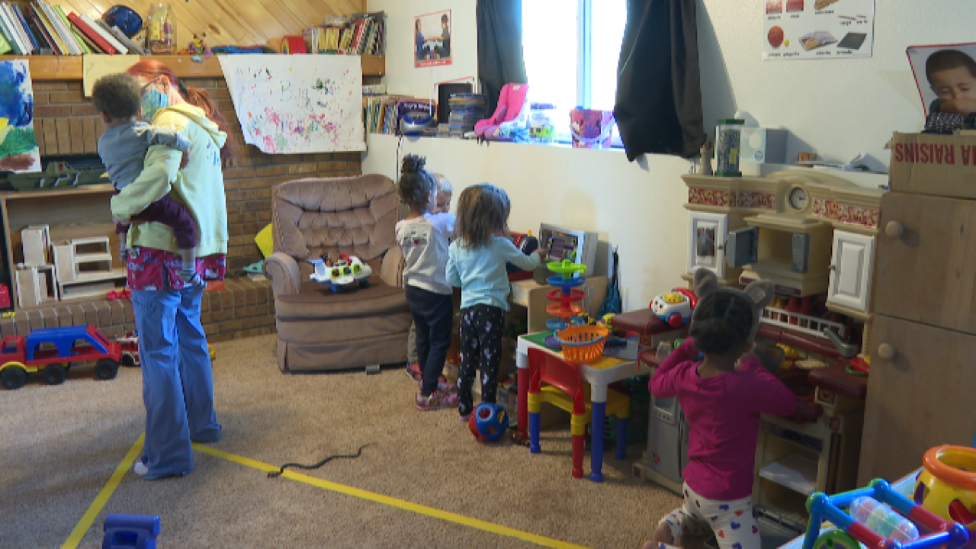

Child Categories and care settings
Infant (0-23months)
Toddler (24-35months)
Preschool (36-54months)
Center-based care
Home-based care
Data Visualization: January 24th, 2021 3/10

Slide 4
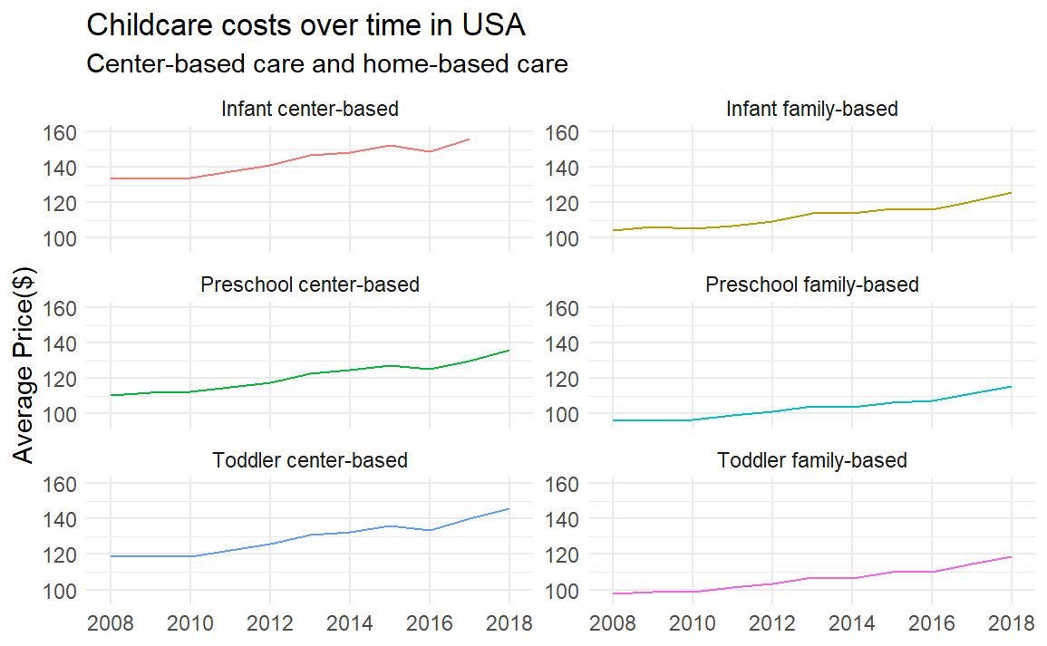
Childcare Costs Over Time in USA(2008-2018)
Both care settings increases as time goes on
In both setting and different age groups, the family-based appears to be lower than the center-based
Infant center>Toddler center>Preschool center
Infant family>Toddler>Preschool
Data Visualization: January 24th, 2024 4/10

Slide 5
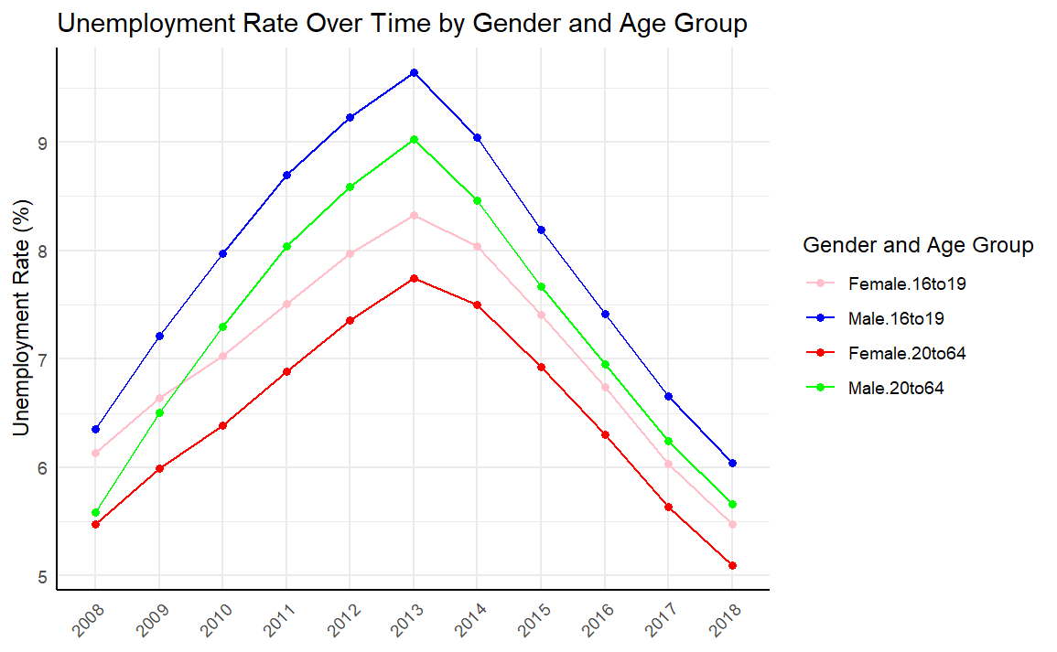
Unemployment Rates Over Time in USA (2008-2018)
Gender and age groups follow the same trend over time.
Unemployment rates increases around 2009-2013
Peaks at 2013, followed by a decrease in unemployment rates for all age group
In both age groups, male unemployement rate are higher than female rates
Age groups 20to64 appear to have lower rates than 16to19
Do the unemployment rate have an impact on childcare costs?
Data Visualization: January 24th, 2024 5/10

Slide 6
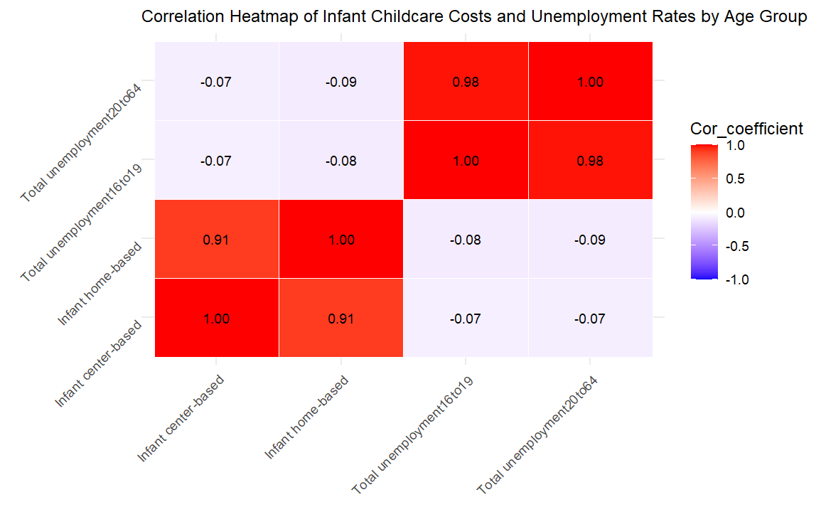
Unemployment Rate and Childcare costs (Infant care settings)
There are several cells with values close to zero, suggesting no correlation between corresponding variables.
Diagonal from bottom left to top right shows perfect correlation
The infant care settings shows negative (close to zero) correlation with unemployment rates
So we can conclude that there’s almost no correlation between childcarecosts and unemployment rates. What about population size and household income?
Data Visualization: January 24th, 2024 6/10

Slide 7
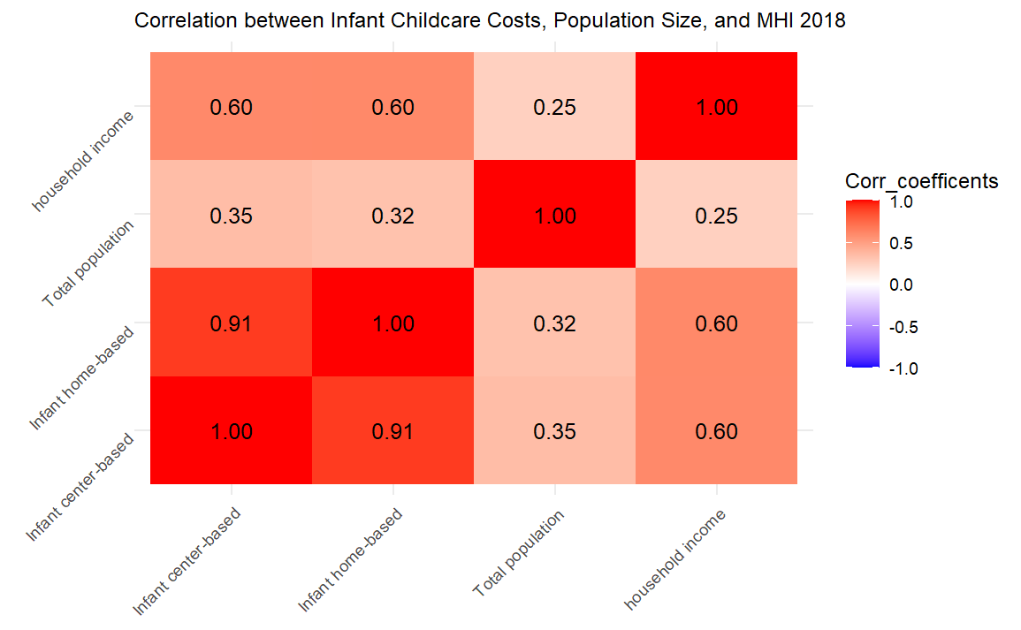
Population size, Household income, and Infant care settings
Both Infant care settings show a positive correlation with the total population and household income
Household income is strongly correlated to care settings compare to total population
Data Visualization: January 24th, 2024 7/10

Slide 8
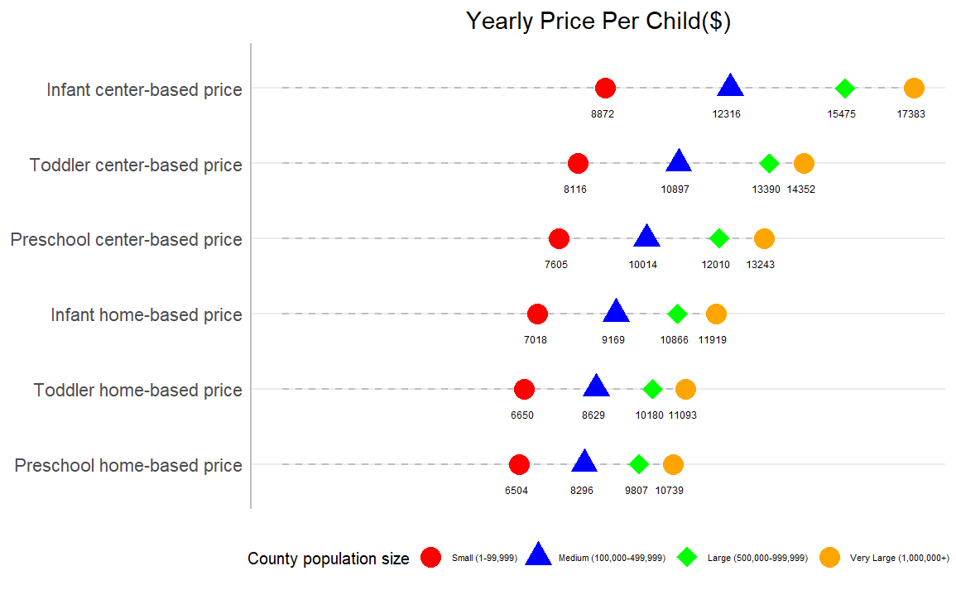
County Childcare Price by Age Group, Care Settings, and County
Population Size
Larger counties tends to have higher childcare costs
Center-based care tends to be more expensive than home-based care, particularly in larger counties
Data Visualization: January 24th, 2024 8/10

Slide 9
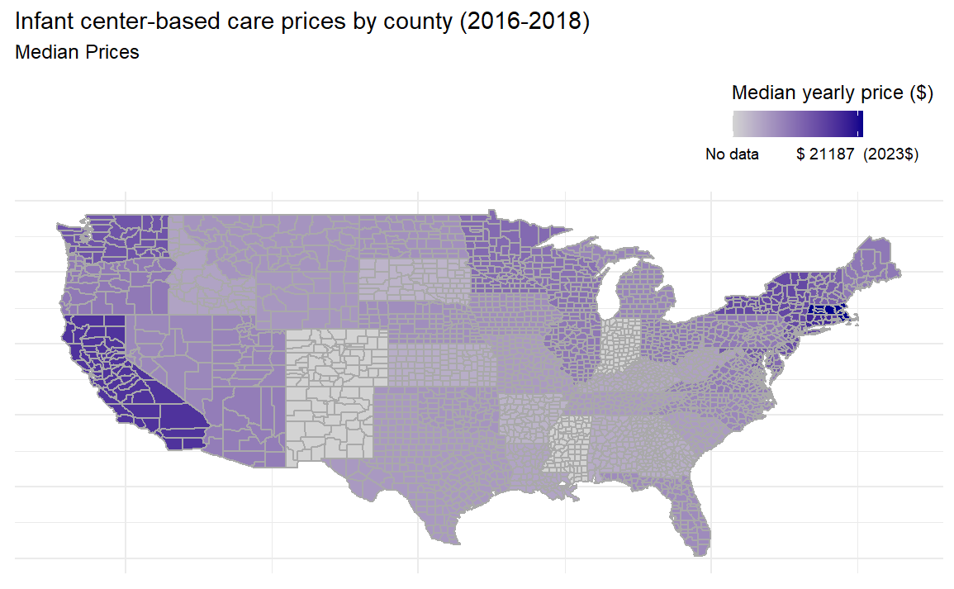
Infant Center-based Prices by County Size (2016-2018)
Data Visualization: January 24th, 2024 9/10

Slide 10
Conclusion
Data Visualization: January 24th, 2024 10/10

Slide 11
Aknowledgment
I will like to Thank Dr. Roland for his valuable guidelines throughout this course
Data Visualization: January 24th, 2024

Slide 12
Thank you for your attention

